Slide 1
Components
Function and Class Components | Props | Component Composition | Components in Modules
Notes:
Welcome to our lecture on components. In this lecture we will go through function and class components, props, component composition, and components in modules. Let’s start the video lecture.

Slide 2

Function and Class Components
React elements are the smallest building blocks of a React app and represent single HTML elements.
Function components are simple functions that return React elements.
Class components extend React.Component and use a render() method to return React elements.
Notes:
In React, elements are the smallest building blocks, representing individual HTML elements. Components are made up of elements and can be created as function or class components. Function components are simple functions that return React elements, while class components extend React Component and use a render method to return elements. Next, we will explore how to use props to pass data between components.

Slide 3
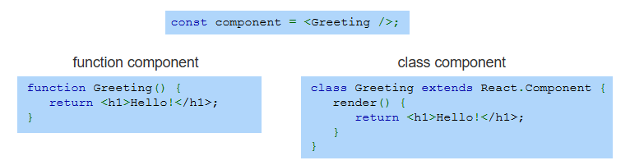
Example
Notes:
In this example, both components return the same h1 element. The function component is a simple function that directly returns JSX. The class component extends React Component and defines a render method to return JSX. Both approaches work, but function components are preferred for their simplicity. Next, we will explore how to pass data between components using props.

Slide 4
Props
Props (properties) are attributes passed to components as an object. Example: <Greeting name="Jasmine" /> creates {name: "Jasmine"}.
Function components receive props as a parameter and use them inside the function.
Class components access props using this.props to retrieve passed data.
Notes:
Props, short for properties, are attributes passed to components as an object. For example, passing a name prop to a Greeting component creates an object with name set to Jasmine. Function components receive props as a parameter, while class components access props using this.props. Props make components reusable and dynamic. Next, we will see an example of props in action.

Slide 5
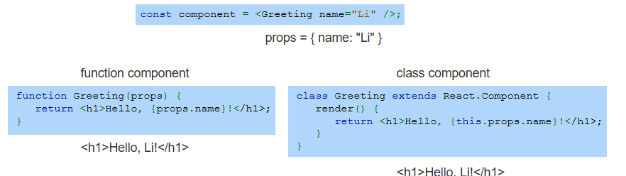
Example
Notes:
In this example, the Greeting component receives a name prop with the value Li. In the function component, props are passed as a parameter and accessed directly. In the class component, props are accessed using this.props. Both methods output Hello, Li. Props allow us to pass dynamic data into components. Next, we will explore how components can be nested within other components.

Slide 6
Component Composition
React apps are built using a root component that manages the overall structure.
Child components are nested inside the root component to break the UI into reusable parts.
Each child component can have its own children, creating a hierarchy of components.
Notes:
React apps are built using a root component that manages the overall structure. Inside the root component, child components are used to break the UI into smaller, reusable parts. Each child component can also have its own children, forming a hierarchy of components. This modular approach improves code organization.

Slide 7
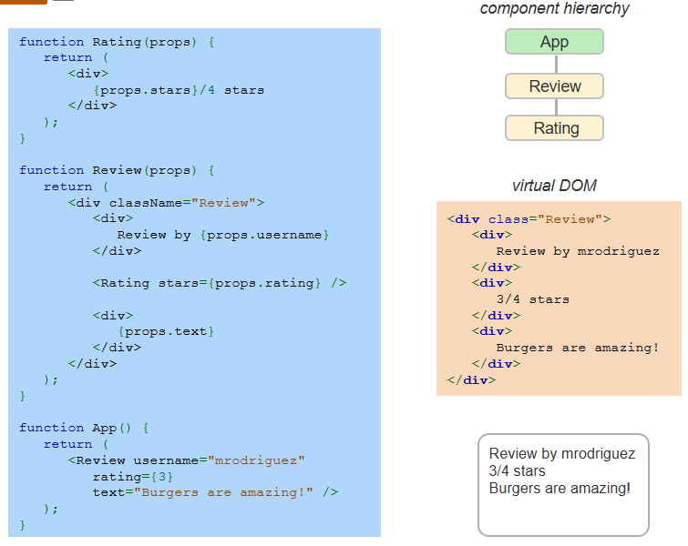
Example
Notes:
This example shows how components are nested within one another. The Rating component displays a rating, while the Review component includes a username, rating, and text. The App component passes props to Review, which then passes data to Rating. This hierarchy makes the UI modular and reusable.

Slide 8
Component In Modules
Modules help organize React components by storing them in separate JavaScript files.
Export statements specify which components or functions can be used in other files.
Import statements bring in exported components or functions for use in a different module.
Notes:
Modules help structure React projects by keeping components in separate JavaScript files. This improves organization and reusability. Export statements define which components can be used elsewhere, while import statements bring those components into other files. This modular approach makes code more maintainable.

Slide 9
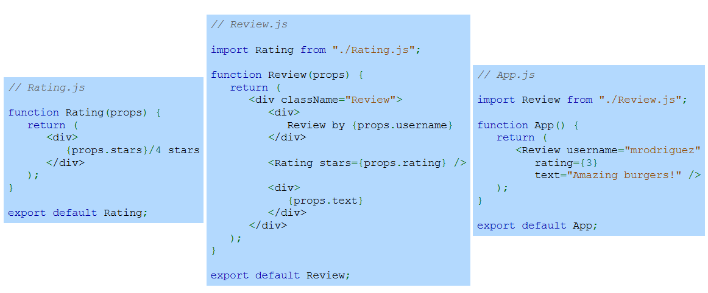
Example
Notes:
This example separates components into different files. Rating dot JS defines a Rating component and exports it. Review dot JS imports Rating and defines a Review component, which is then exported. Finally, App dot JS imports Review and uses it in the main application. This modular approach improves code organization and reusability.

